Slide 1



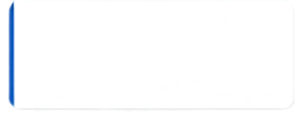










Visual Directions
• Layout: Split-screen modern dashboard layout (16:9).
• Left Panel: Deep Navy card (#1E3A8A) with title, 8–10 min duration tag, and Behavior-First badge.
• Right Panel: Character portrait of "Alex" at a workstation, looking overwhelmed next to missed deadline notifications.
• UI Elements:
- Progress bar indicator (Slide 1 of 9).
- Primary CTA Button: [Start Scenario →] with hover effect.
- Audio and CC toggles at upper right.
20 MINUTE MODULE
The Performance Dilemma
DEADLINE MISSED
Project update was due 2 days ago
STAKEHOLDER FEEDBACK
Concerns about responsiveness and follow-through
BEHAVIOR-FIRST APPROACH
Alex has missed deadlines twice in the last month, and stakeholder feedback is slipping.
ACTION NEEDED
Address before performance continues to decline
You know the first conversation matters—what you say next sets everything in motion.
START SCENARIO
AUDIO ON
CC
CAPTIONS ON
Notes:
When a reliable direct report starts slipping, how you handle that first conversation makes all the difference.
In this 8-to-10 minute microlearning experience, you will step into the manager's role, make real-time decisions, and build an actionable path forward.
Click ‘START SCENARIO' to begin.

Slide 2








Visual Directions
• Layout: Clean 3-card horizontal grid layout over a soft slate background.
• Visuals: 3 distinct icon cards representing:
1. Target Icon: Objective Preparation
2. Dialogue Speech Bubbles: Real-time De-escalation
3. Clipboard Checklist: Action Commitment
• UI Elements:
- Slide Progress: 2 of 9.
- Primary CTA Button: [Proceed →] at bottom right.
Learning Objectives
By the end of this module, you will be able to:
Prepare with Purpose
Navigate Resistance
Drive Commitment
Plan conversations with clarity and confidence.
Recognize and address common reactions with empathy.
Collaborate on clear next steps and expectations.
Set goals, gather facts, and consider impact.
Stay calm, listen actively, and keep the conversation on track.
Build ownership and follow through to sustain performance.
Proceed
Notes:
Here are our target outcomes for this session:
First, prepare using verifiable facts rather than assumptions.
Second, navigate pushback with calm authority and empathy.
And third, lock in clear milestone commitments that drive lasting change.
Click 'Proceed' to continue.

Slide 3

























Pre-Conversation Preparation
Visual Directions
• Layout: 3-column interactive card deck:
- Card 1: MUST KNOW (Data & Facts)
- Card 2: SHOULD KNOW (Emotional Mindset)
- Card 3: REFERENCE (Policy & Support)
• Interactive Dial: Circular "Readiness Gauge" (0% → 100%).
• Micro-interactions: Checkboxes expand accordion details on click.
• Bottom Bar: [Meet Alex →] (Disabled until all 3 cards are visited).
Check each item to reveal details and build your readiness.
MUST KNOW
SHOULD KNOW
REFERENCE
Your readiness
Clarify the performance gap
Clarify the performance gap
Explore possible reasons
Explore possible reasons
Company policies
Company policies
Be specific about what's not meeting expectations.
Consider context that may be impacting performance.
Review relevant policies and HR guidelines.
3
9
of
Gather objective evidence
Gather objective evidence
Identify desired outcomes
Identify desired outcomes
Role expectations
Role expectations
Collect facts, examples, and dates to reference.
Define what success looks like moving forward.
Check job description and key responsibilities.
33% complete
Check all items to unlock your conversation.
Understand past conversations
Understand past conversations
Plan support and resources
Plan support and resources
Team and project context
Team and project context
Review prior feedback and any agreed action steps.
Think through training, tools, or coaching that can help.
Understand current priorities and deadlines.
Meet Alex
Thorough preparation builds confidence and sets the stage for a productive conversation.
Notes:
Preparation makes or breaks difficult conversations. Review each layer: compile objective evidence, check your emotional mindset, and keep organizational support tools ready. Once all three are checked, enter the meeting room.

Slide 4









Visual Directions
• Layout: First-person point-of-view meeting setup across an office desk.
• Character Expression: Alex is seated across, displaying neutral, guarded body language.
• Bottom UI: 3 clickable dialogue choice cards (Options A, B, and C).
• Feedback Drawer: Slides in from the bottom upon selection with immediate scoring impact.
Opening the Conversation
Your opening sets the tone. Choose how you'll begin.
YOUR OPENING CHOICE
FEEDBACK
Let's talk about your performance.
Best practice
Direct and to the point.
Open with curiosity to invite honest dialogue and lower defensiveness. It builds trust and keeps the conversation collaborative.
How are things going with your work?
Open-ended and curious.
IMPACT
I need to address a concern.
Builds trust
Encourages openness
Creates a shared agenda
Signals a problem up front.
Notes:
How you open the conversation sets the tone. Being overly aggressive triggers defensiveness; being too vague avoids the real issues. Choose the opening that maintains standards while preserving respect.

Slide 5








Visual Directions
• Layout: Split dialogue view with speech callout over Alex, who displays visible frustration.
• Right Panel: 2 Manager response choice cards.
• Comparison Panel: Displays immediate behavioral trajectory: "Arguing the Blocker" vs. "Validating Pressure & Refocusing on Communication".
Navigating Resistance and Pushback
Choose the response that validates, redirects, and drives accountability.
OPTION 1
OPTION 2
Alex says:
Validate and redirect
Dismiss and defend
“I already have too much on my plate. These expectations aren’t realistic.”
“I hear that your workload is heavy. Let’s review priorities together and focus on what matters most.”
“These are the expectations. You need to figure out how to make it work.”
Why it works
Why it’s risky
Shows empathy and understanding
Can increase defensiveness and frustration
Shifts the focus to priorities and solutions
Keeps the focus on blame instead of solutions
Select the response you would choose.
Think about the impact.
Notes:
When faced with defensiveness, our instinct is often to argue the facts. But effective leaders validate the real friction first, then pivot immediately to accountability and proactive communication. Choose your response.

Slide 6
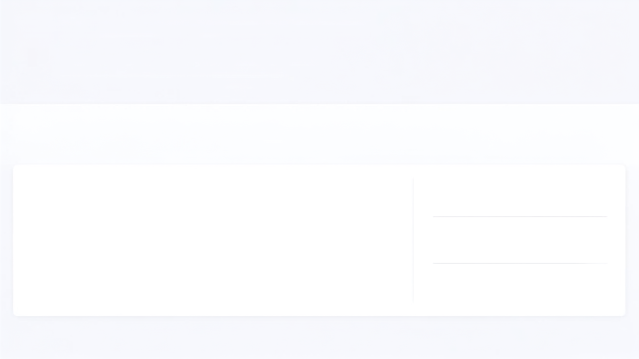























2
Visual Directions
• Layout: Horizontal 4-step Action Commitment Stepper:
1. Identify Root Cause (Process & Escalation Gap)
2. Co-Design Solution (Daily Slack Check-in)
3. Establish Milestones (Day 7, 14, 30)
4. Mutual Confirmation (Written Summary)
• Interactive Cards: Click each milestone marker to reveal follow-up criteria.
Building the Way Forward: Performance Commitment
Structure an actionable, milestone-based agreement.
1
2
3
4
Identify Root Cause
(Process & Escalation Gap)
Co-Design Solution
(Daily Slack Check-in)
Establish Milestones
(Day 7, 14, 30)
Mutual Confirmation
(Written Summary)
Click all milestone cards to inspect review parameters.
AGREED ROOT CAUSE
QA bottleneck combined with late escalation
Day 7 Check-in
Day 14 Check-in
Day 30 Review
AGREED FIX
Daily 5-minute asynchronous Slack blocker check-in
Zero unreported blockers; next milestone delivered on schedule.
Quality sync with QA lead; defect rate under 2%.
Full sprint autonomy restored.
MUTUAL SIGN-OFF
Summary emailed within 2 hours of the meeting
Take the Manager Challenge
6 of 9
Notes:
A conversation without clear follow-up milestones is just an uncomfortable talk. Notice how this structure transfers ownership back to Alex, while setting clear review checkpoints at 7, 14, and 30 days. Both of you leave aligned on what success looks like.

Slide 7




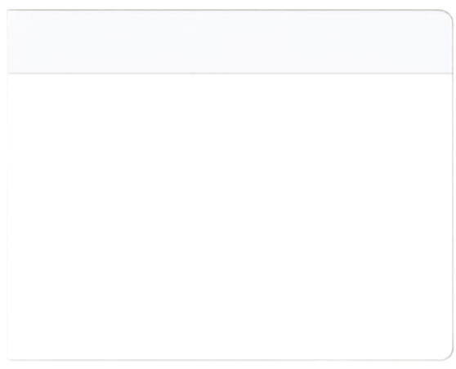

















The Manager Challenge: Application Under Pressure
Visual Directions
• Layout: Gamified scenario transfer card.
• Visuals: Contextual Slack chat window mock-up on left; 3 decision buttons on right.
• Top Bar: Pacing indicator bar and score badge (+10 pts).
• Feedback Drawer: Explanatory rationale confirming behavioral transfer to real workplace situations.
The scenario below and choose the best response.
+10 pts
What would you do?
slack
#qa-squad
A
A
Step in immediately and message
the QA manager to fix the bottleneck for Alex.
Channels
# team-general
Alex
10:14 AM
# product-updates
QA turnaround is slow again.
The sprint milestone might be delayed.
B
B
Acknowledge early escalation and coach ownership:
“Thanks for flagging early, Alex. What is your proposed workaround before we escalate together?”
#qa-squad
# random
💖 2
C
C
Wait until the deadline passes,
then schedule another formal meeting.
Direct Messages
Alex
Message #qa-squad
Correct!
Choice B reinforces proactive problem ownership while validating early communication. Intervention directly. Choice A, breeds dependency, while waiting, Choice C, damages team delivery.
TRANSFER SCENARIO
•
Two weeks later, Alex posts in Slack: QA turnaround is slow again.
The sprint milestone might be delayed.
Notes:
Now let's test your judgment in a transfer scenario. How you respond when familiar friction resurfaces determines whether new habits stick.

Slide 8


























Visual Directions
• Layout: 5-step horizontal process infographic card illustrating the core conversation architecture:
[ CONTEXT ] → [ KNOW ] → [ PRACTICE ] → [ FEEDBACK ] → [ APPLY ]
• Below the infographic: 5 concise bullet cards summarizing core manager takeaways.
• UI Elements:
- Slide Progress: 8 of 9.
- Primary CTA Button: [Continue to Wrap-Up →] at bottom right
Summary Pointers: Key Takeaways!
CONTEXT
KNOW
PRACTICE
FEEDBACK
APPLY
1. Ground in Facts
2. Lead with Empathy
3. Maintain Standards
4. Drive Ownership
5. Lock in Checkpoints
Focus on observable dates, deliverables, and impacts – never subjective assumptions
Acknowledge legitimate friction and emotional reactions before redirecting to solutions.
Being supportive does not mean lowering performance expectations.
Prompt the employee to propose the fix rather than prescribing it yourself.
Anchor every conversation to specific 7-14-30 day review milestones.
Continue to Wrap-Up
Continue to Wrap-up
Notes:
Let's summarize the key takeaways from this framework: Ground every conversation in observable facts, acknowledge genuine friction with empathy, maintain clear performance standards, transfer solution ownership to the employee, and lock in firm 7, 14, and 30-day review milestones.
Click 'Continue to Wrap-Up' to conclude.

Slide 9





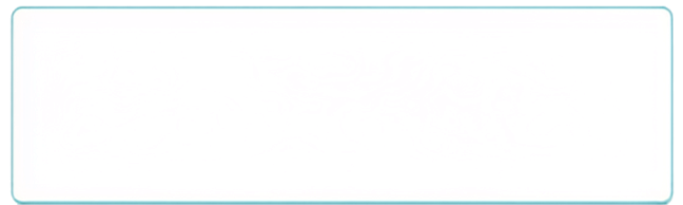










Visual Directions
• Layout: Dual-panel conclusion and wrap-up screen.
• Left Panel: "Thank You & Completion" card with completion badge, final score display, and LMS status confirmation.
• Right Panel: Action reflection card featuring an interactive multi-line text entry box.
• Bottom Bar: [Download Job Aid (PDF)] and [Exit Module ✓] buttons.
Course Completed!
9 of 9
Thank You for Participating!
Your Next Step: On-the-Job Action Prompt
Identify one performance issue on your team that you have been postponing. Draft your factual opening statement below:
You have successfully completed the Manager's Guide to Difficult Performance Conversations.
Type your opening statement here...
FINAL SCORE
92%
Great work!
Takeaway Resource
LMS STATUS
Download Job Aid (PDF)
Module Completed
A one-page reference to support your performance conversations.
Your progress has been recorded.
Save Reflection
Download Job Aid (PDF)
Exit Module
Notes:
Congratulations on completing this module. Remember: clarity is kindness. By preparing with facts, addressing resistance calmly, and securing concrete milestones, you turn challenging discussions into opportunities for professional growth. Download your job aid, record your action commitment, and exit the module.

